Slide 1
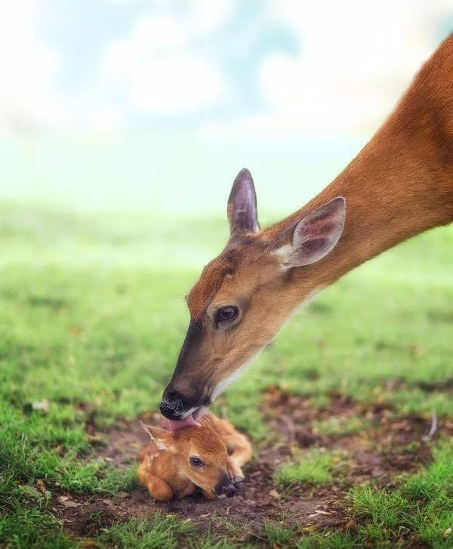
宁波十校联考续写The Water of Life评析

Slide 2
The Water of Life
It was one of the hottest days of the dry season. We had not seen rain in almost a month. The crops were dying. Cows had stopped giving milk. The creeks and streams were long gone back into the earth. It was a dry season that would bankrupt several farmers before it was through. Every day, my husband and his brothers would go about the tiring process of trying to get water to the farm. If we didn’t see some rain soon, we would lose everything.
It was on this day that I learned the true lesson of sharing and witnessed the only miracle I have seen with my own eyes. I was in the kitchen making lunch for my husband and his brothers when I saw my six-year-old son, Billy, walking toward the woods. He wasn’t walking with the usual carefree abandon of a youth but with a serious purpose. I could only see his back. He was obviously walking with a great effort trying to be as still as possible. Minutes after he disappeared into the woods, he came running out again toward the house. I went back to make sandwiches, thinking that whatever task he had been doing was completed.
Moments later, however, he was once again walking in that slow purposeful stride toward the woods. This activity went on for over an hour: walking carefully to the woods, and then running back to the house. Finally, my curiosity got the best of me. I crept out of the house and followed him on his journey.
He was cupping both hands in front of him as he walked, very careful not to spill the water he held. Maybe two or three tablespoons were held in his tiny hands. I sneaked closer as he went into the woods. Branches and thorns slapped his little face but he did not try to avoid them. He had a much greater purpose. As I leaned in to spy on him, I saw an amazing sight. A mother deer with a huge pair of deer horns appeared in front of him, with a baby fawn(幼鹿) lying on the dry ground. I almost screamed to get him away.
Paragraph 1
However, Billy walked right up to them. _____________________________________________________________
Paragraph 2
I witnessed the most beautiful heart working hard to save a life. ____________________________________________

Slide 3
Summary of the story
sign
The dry season had lasted quite a while without any _____ of rain. The farmers suffered a lot, _________ (struggle) to find water for their farms, but without luck. Everything seemed likely to be lost unless any luck _________ came.
But a miracle did happen to my son Billy. While I was preparing dinner, I coincidentally found that he was going to and _____ the woods with great efforts. Out of _________ (curious), I followed him, trying to work out what he was realy up to. Billy held some water in his ___ __ (cup) hands and came to the woods, _______the baby fawn was lying on the ground with her mother for company. The fawn was badly in need of water, obviously too thirsty and too weak to rise to his ______ (foot).
struggling
miracle
from
curiosity
cupped
where
feet
Water mattered a lot!

Slide 4
The Water of Life
It was one of the hottest days of the dry season. We had not seen rain in almost a month. The crops were dying. Cows had stopped giving milk. The creeks and streams were long gone back into the earth. It was a dry season that would bankrupt several farmers before it was through. Every day, my husband and his brothers would go about the tiring process of trying to get water to the farm. If we didn’t see some rain soon, we would lose everything.
It was on this day that I learned the true lesson of sharing and witnessed the only miracle I have seen with my own eyes. I was in the kitchen making lunch for my husband and his brothers when I saw my six-year-old son, Billy, walking toward the woods. He wasn’t walking with the usual carefree abandon of a youth but with a serious purpose. I could only see his back. He was obviously walking with a great effort trying to be as still as possible. Minutes after he disappeared into the woods, he came running out again toward the house. I went back to make sandwiches, thinking that whatever task he had been doing was completed.
Moments later, however, he was once again walking in that slow purposeful stride toward the woods. This activity went on for over an hour: walking carefully to the woods, and then running back to the house. Finally, my curiosity got the best of me. I crept out of the house and followed him on his journey.
He was cupping both hands in front of him as he walked, very careful not to spill the water he held. Maybe two or three tablespoons were held in his tiny hands. I sneaked closer as he went into the woods. Branches and thorns slapped his little face but he did not try to avoid them. He had a much greater purpose. As I leaned in to spy on him, I saw an amazing sight. A mother deer with a huge pair of deer horns appeared in front of him, with a baby fawn(幼鹿) lying on the dry ground. I almost screamed to get him away.
________________________________________

Slide 5
Key sentence: It was on this day that I learned the true lesson of sharing and witnessed the only miracle I have seen with my own eyes.
第一段主要从母亲的视角（见证者) sharing water
第二段是什么样的miracle？
A mother deer with a huge pair of deer horns appeared in front of him, with a baby fawn(幼鹿) lying on the dry ground. I almost screamed to get him away.
第一段母亲的心理（从开始的担心惊恐到感动）

Slide 6
Design the plot-- first sentences
Paragraph1
However, Billy walked right up to them.
sharing
How did Billy feed the fawn?
How did the fawn react to Billy’s kindness and what did he do?
What did the mother deer do?
The story is told from the mother’s perspective.
Paragraph2
I witnessed the most beautiful heart working hard to save a life.
What did I do after witnessing the whole thing?
How did Billy react to my sudden appearance?
What miracle happened?
(--rain，How to end your composition perfectly?)
miracle

Slide 7

miracle
The rain that came that day was a miracle, saving our farm, just like my boy saved a life.
And what a miracle! The tears on my cheeks turned into the long-expected rain from the sky!
Then I felt something wet on my face. What a miracle! --- It was not the tears out of my eyes, but rain drops from the sky!
And at that time, the miracle we had been praying for showered us -- the long- expected life of water finally fell on this dry land！
. Miraculously, out of nowhere came a constant shower of rain,
as if in answer to Billy’s act of kindness.

Slide 8
Design the plot-- hint:
Given information | predictable plot
Para 1:We had not seen rain in almost a month + Para 2: miracle
Para 2:walking...with a serious purpose; with a great effort trying to be as still as possible Walk out with a serious prurpose; run out again towards the house
Para 3:my curiosity got the best of me. I crept out ... followed him on his journey
Para 4:A mother deer with a huge pair of deer horns appeared in front of him, with a baby fawn(幼鹿) lying on the dry ground.
文章结尾：雨水奇迹般地降临，呼应miracle.
如此郑重其事地对待，第一段可以写Billy看到小鹿站起来后地高兴劲。Seeing the cute creature back on its feet, Billy jumped up with joy, as if having saved the whole world.
越是好奇，第二段写越是感动。Never could I have imagined that my young should be blessed with such a generous heart.
母鹿在边上，有威胁性。这样在第一段就凸显孩子的勇敢，也可写母鹿态度的改变。The nervous mother deer, who had all the time been around , now breathed a sigh of relief .

Slide 9
Describe what I witnessed vividly
How did Billy feed the fawn?
Cautiously, Billy crouched down by the weak fawn, holding the water in his cupped hands and slowly sending it to its mouth.
Anxiously yet gently, he knelt down beside the baby fawn, carefully stretched his arms, and sent the two or three tablespoons to its mouth.
He crouched gingerly(cautiously) in front of the fawn, stretching out his hands with the water in the palms. “Drink it!” he murmured/coaxed(诱哄）.
Cautiously, Billy approached the poor fawn and reached out his cupped hands, signalling （示意）the fawn to drink the water.

Slide 10
Describe what I witnessed vividly
What did the fawn do?
The baby fawn lifted its weak head with great efforts and eagerly lapped（舔着喝) the water up in his cupped hands .
The poor creature, apparently in desperate need of water, licked it up quickly/sipped with its shell-pink tongue.
The thirsty fawn drank/swallowed the water greedily, and much to my surprise, the feeble（very weak) creature struggled to its feet slowly.
Instinctively, the fawn stuck out his tongue and eagerly sucked every drop of water. Thirst satisfied, the fawn looked up at little Billy, licking his moistured lips, as if a sign of gratitude.

Slide 11
Describe what I witnessed vividly
What did the mother deer do?
The mother deer stood by as if in guard, closely staring at my son until his baby licked out of the last drip.
The mother deer lowered her head and licked my boy’s cheek gently, as if expressing gratitude.
The mother deer, who had all the time been around, breathed a sigh of relief though she herself was so thirsty that her lips were was cracking.

Slide 12
Design the plot-- first sentences
I witnessed the most beautiful heart working hard to save a life.
Paragraph2
What did I do after witnessing the whole thing?
1.Before he tried to explain, I strode to him and held him tight.
2.Deeply touched by his act of kindness, I strode over and gathered my young into my arms tightly, tears of pride rolling down my cheeks and his back.
3. Never could I have imagined that my young should be blessed with such a generous heart.

Slide 13
Design the plot-- first sentences
Paragraph2
I witnessed the most beautiful heart working hard to save a life.
How did Billy react to my sudden appearance?
1.A little embarrassed but still proud, he shared the whole story with me, saying that if he didn’t offer the helping hand, the fawn would end up being thirsty to death.
2.Somewhat surprised at my suddent appearance, he appeared a little embarrassed and ran into my arms.
3.He couldn’t wait to share the whole thing with me.

Slide 14
Paragraph2
I witnessed the most beautiful heart working hard to save a life.
What miracle happened? (--rain, How to end your composition perfectly?)
1And miraculously, the tears on my cheeks turned into the long-expected rain from the sky!
2.I looked up at the sky. It was as if God, Himself, was weeping with pride. The rain that came that day was a miracle, saving our farm, like my boy saved a life.
3.It must be God’s answer to people’s call for the rain, and also a reward for Billy’s act of kindness!

Slide 15

参考范文
However, Billy walked right up to them. Cautiously, he knelt down by the weak baby fawn, seemingly familiar with the two creatures. The fawn, suffering from dehydration and heat exhaustion lifted its head up with great efforts and eagerly lapped up the water cupped in my beautiful boy’s hands. The mother deer stood by as if in guard. Not until the fawn licked the last drip of water did Billy move a little bit. I contained myself not to make a slightest sound, for fear of scaring them. (81)
I witnessed the most beautiful heart working hard to save a life. With the water gone, Billy jumped to his feet and met my smiling eyes. Before he tried to explain, I strode to him and held him tight. As the tears that rolled down my face began to hit the ground, they were suddenly joined by other drops and more drops and more. I looked up at the sky. It was as if God, Himself, was weeping with pride. The rain that came that day was a miracle, saving our farm, just like my boy saved a life. (87)

Slide 16
Para1:
However, Billy walked right up to them. Cautiously he knelt down by the weak baby fawn, seemingly familiar with the two creatures. The fawn suffering from dehydration and heat exhaustion lifted its head up with great efforts and eagerly lapped up the water cupped in my beautiful boy’s hands. The mother deer stood by as if in guard. Not until the fawn licked the last drip of water did Billy move a little bit. I contained myself not to make a slightest sound, for fear of scaring them.

Slide 17
para2
I witnessed the most beautiful heart working hard to save a life. With the water gone, Billy jumped to his feet and met my smiling eyes. Before he tried to explain, I strode to him and held him tight. As the tears that rolled down my face began to hit the ground, they were suddenly joined by other drops and more drops and more. I looked up at the sky. It was as if God, Himself, was weeping with pride. The rain that came that day was a miracle, saving our farm, just like my boy saved a life.

Slide 18
参考范文
Para1:
However, Billy walked right up to them. Cautiously he knelt down by the weak baby fawn, seemingly familiar with the two creatures. The fawn suffering from dehydration and heat exhaustion lifted its head up with great efforts and eagerly lapped up the water cupped in my beautiful boy’s hands. The mother deer stood by as if in guard. Not until the fawn licked the last drip of water did Billy move a little bit. I contained myself not to make a slightest sound, for fear of scaring them.
I witnessed the most beautiful heart working hard to save a life. With the water gone, Billy jumped to his feet and met my smiling eyes. Before he tried to explain, I strode to him and held him tight. As the tears that rolled down my face began to hit the ground, they were suddenly joined by other drops and more drops and more. I looked up at the sky. It was as if God, Himself, was weeping with pride. The rain that came that day was a miracle, saving our farm, just like my boy saved a life.
呼应“over an hour”
喂水场景描写
照应sharing
动作表现
我的感受
揭示miracle 并点题

Slide 19

下水作文及点评：
However, Billy walked right up to them. Carefully, he reached out his tiny cupped hands, his shining eyes expectantly looking at the fawn. Instinctively, the fawn approached, stuck out his tongue and eagerly sucked every drop of water. Thirst satisfied, the fawn looked up at little Billy, licking his moistured lips, as if a sign of gratitude. The mother deer, who had all the time been around, breathed a sigh of relief though she herself was so thirsty that her throat was burning dry. Seeing the fawn back on his feet, Billy, my baby, was more than delighted, as if he had saved the world.
（97）
作文点评：
1.carefully, instinctively等评注性状语置于句首，凸显动作神态。
2.looking, licking, seeing等非谓语动词的运用，使文章方式变得多样化。
3.动作链和独立主格的运用，使句子变得紧凑，动作之间的紧密联系得到加强。
4.动作和心理活动的穿插运用，使文章有了生命色彩。
5.高级词块stick out, thirst satisfied, burn dry, back on one’s feet.

Slide 20
下水作文及点评：
I witnessed the most beautiful heart working hard to save a life. Deeply touched by his act of kindness, I strode over and gathered my young into my arms tightly, tears of pride rolling down my cheeks and his back. A little embarrassed but still proud, he shared the whole story with me, saying that if he didn’t offer the helping hand, the fawn would end up being thirsty to death. And miraculously, the tears on my cheeks turned into the long-expected rain from the sky! It must be God’s answer to people’s call for the rain, and also a reward for Billy’s act of kindness!(97)
作文点评：
1.a little embarrassed but still proud形容词置于句首，miraculously等评注性状语置于置于句首，凸显动作神态。
2.多处分词和独立主格的运用，使文章表达方式变得多样化。
3.结尾两句的点题，精彩地诠释了文中miracle的意义，高明！语言也有韵律感。
4.高级词块tears of pride, end up doing, long-expected.

Slide 21
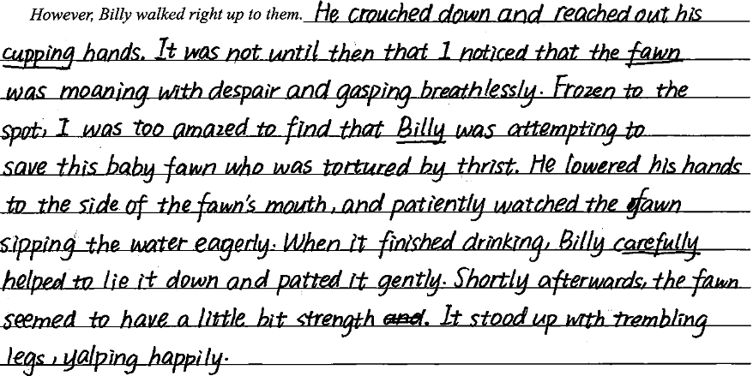
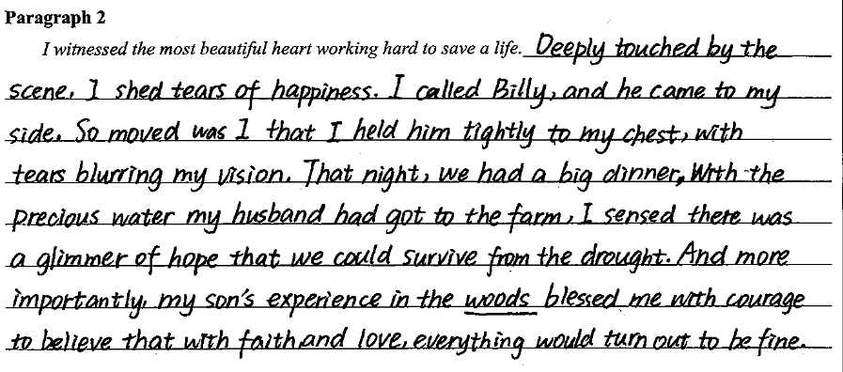
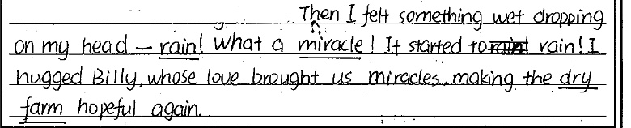
Comment on your writing
优点：对于小鹿的描写和Billy救治小鹿的动作描写非常细腻生动，如moan with despair, gasp, crouch down, reach out等。 第一段的内容比较饱满，充满画面感。
不足：第二段还未对两只鹿的故事交代清楚，时间迅速转到了晚上。没有揭示前文所说的miracle究竟是什么，也没有对文章标题进行呼应，有些偏离了主旨。

Slide 22
He wasn’t walking with the usual carefree abandon of a youth but with a serious purpose.
Minutes after he disappeared into the woods, he came running out again toward the house.
I crept (蹑手蹑脚地走) out of the house and followed him on his journey.
He was cupping (窝成杯状) both hands in front of him as he walked, very careful not to spill the water he held.
I sneaked (crept) closer as he went into the woods.
I almost screamed to get him away.
★
It’s better to follow the language style.

Slide 23
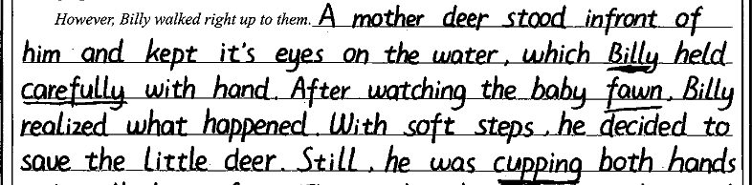
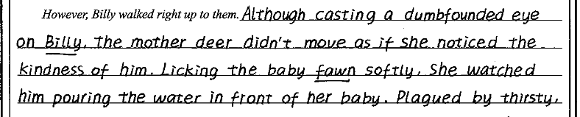
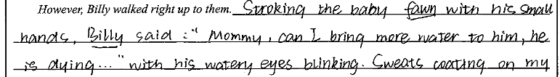
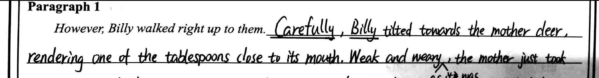
Can you find out the problems in the following excerpts?
逻辑不连贯：
与前文矛盾

Slide 24
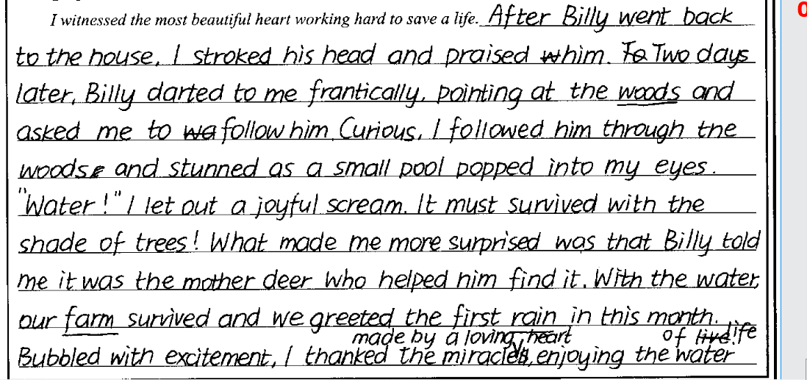
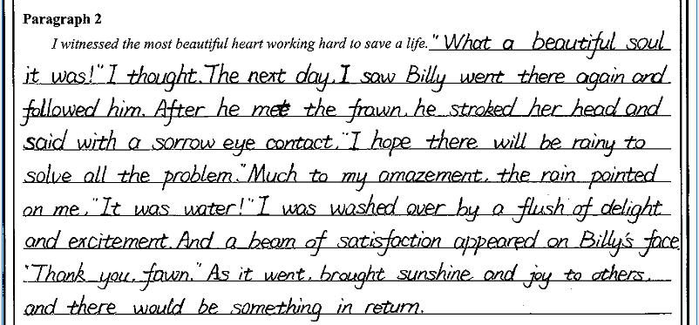
Can you find out the problems in the following excerpts?
矛盾：It was on this day that I learned the true lesson of sharing and witnessed the only miracle I have seen with my own eyes. (Para2)

Slide 25
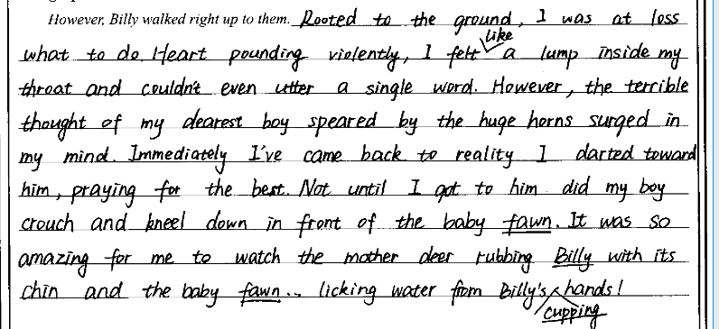
Can you find out the problem in the following excerpt?
中心情节

Slide 26
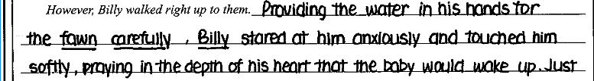
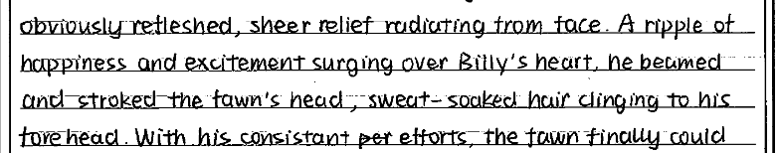
Can you find out the problems in the following excerpts?
全知视角

Slide 27
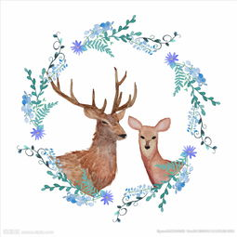
Thank You

